Slide 1


Movies Extensive Dataset
Presenter: Nina Ni
Dec 2020

Slide 2
Contents
Background of IMDb
Dataset
General Analysis & Research Topic
Text Analysis
Linear Model
EDAs & Logistic Regression Model
Prediction
Conclusion

Slide 3
Background
Rotten Tomatoes VS IMDb
IMDb began as a movie database on the Usenet group "rec.arts.movies" in 1990 and moved to the web in 1993.
IMDb is the most popular movie website, and it combines movie description, production company, user ratings and reviews, release dates, and many more aspects.
The website is well known for storing almost every movie that has ever been released.
IMDb’s reviews come solely from users. It has weighted average score system.

Slide 4
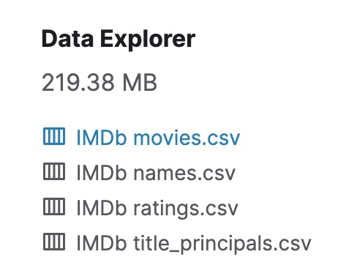
Dataset from Kaggle: https://www.kaggle.com/stefanoleone992/imdb-extensive-dataset
The movies dataset includes 85,855 movies with attributes such as movie description, average rating score, number of votes, genre, budget, etc.
The ratings dataset includes 85,855 rating details from demographic perspective such as female and male’s average rating score, US & Non-US voters' rating score.

Slide 5
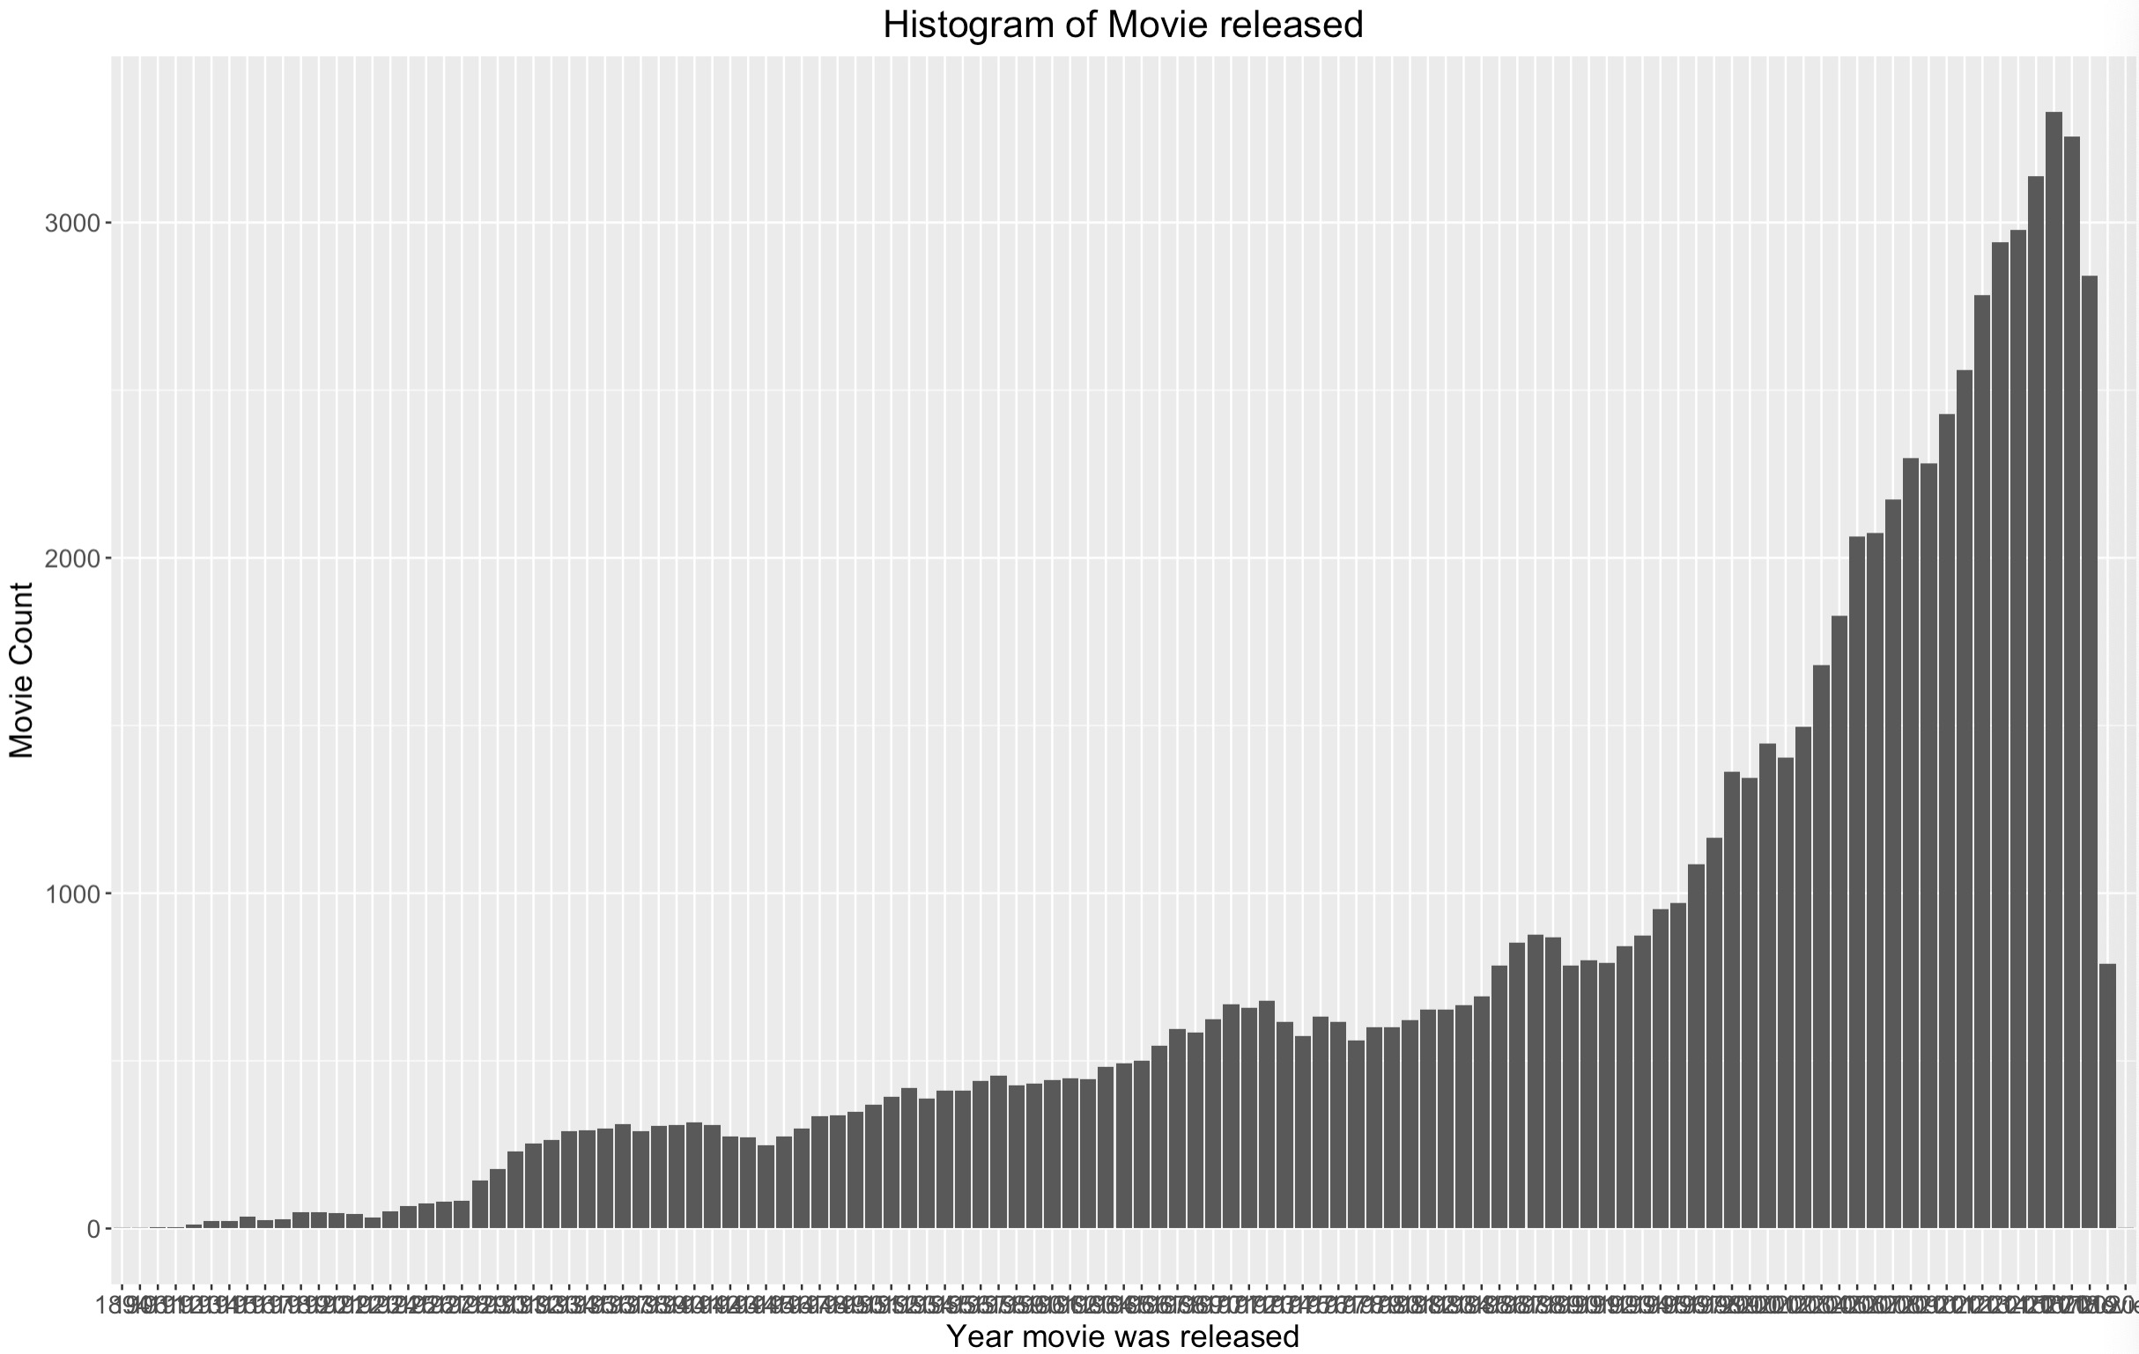
General Analysis-Movies
Year of Movie Releases
1894
2020

Slide 6
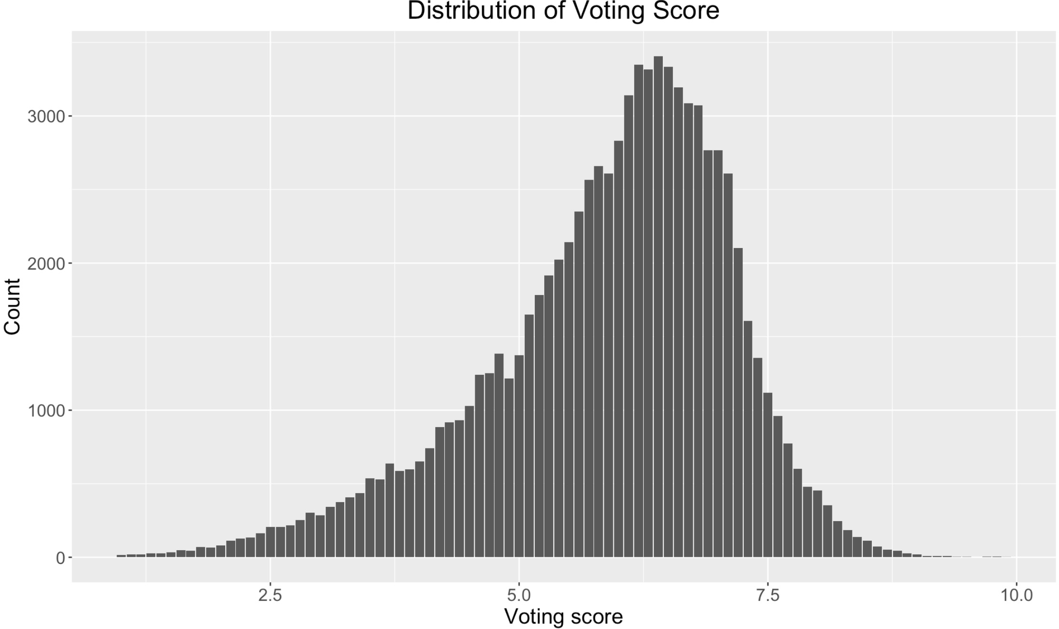
General Analysis-Voting Score
Distribution of Voting Score
Total votes:
815,063,550
Mean of total voting score:
5.9
1
10

Slide 7
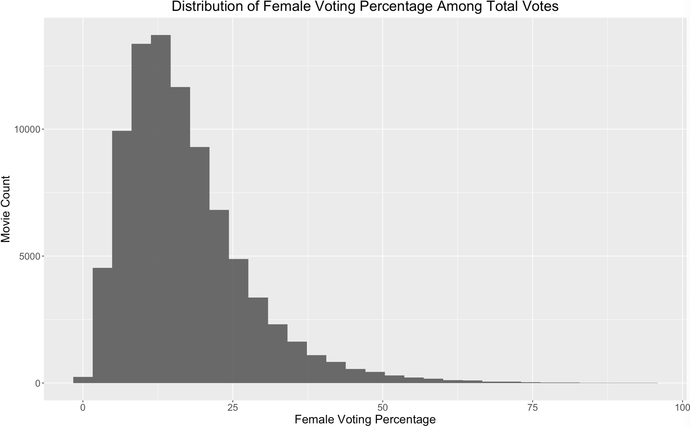
General Analysis-Gender Differences
Female Voting Percentage
Total female votes:
117,232,426
Total male votes:
517,615,103
Men rate more
Women rate more
Female votes only take 18.5% of the total votes. More ratings on IMDb come from men.

Slide 8
General Analysis-Gender Differences
title | year | genre | country | males_average | females_average | difference
Adutha Chodyam | 2019 | Drama | India | 1.2 | 10 | -8.8
Shut Up and Deal | 2007 | Comedy | Canada | 1.4 | 10 | -8.6
Feedback | 2017 | Comedy, Drama, Thriller | USA | 1.6 | 10 | -8.4
Leera the Soulmate | 2018 | Animation | India | 1.2 | 9.5 | -8.3
Isha | 2020 | Drama, Horror | India | 2 | 10 | -8
The WormKillers' Last Spring | 1994 | Drama, Sport | USA | 2.1 | 9.8 | -7.7
Shelter in the Storm | 1987 | Drama, Family | USA | 1.8 | 9.4 | -7.6
Parentesi tonde | 2006 | Comedy | Italy | 1.2 | 8.5 | -7.3
The Belly of the Beast | 2008 | Horror | USA | 2.9 | 10 | -7.1
Carmen's Kiss | 2010 | Drama, Romance, Thriller | UK | 2.8 | 9.8 | -7
Street Revenge | 2008 | Action, Crime | USA | 3 | 10 | -7
Bonne année | 2008 | Drama | Costa Rica, Argentina | 3 | 10 | -7
Paging Emma | 1999 | Drama | Puerto Rico | 2.1 | 9 | -6.9
Midway - Tra la vita e la morte | 2013 | Horror, Thriller | Italy | 2.2 | 9 | -6.8
The Third Testament: The Antichrist and the Harlot | 2009 | Action | UK | 2.3 | 9 | -6.7
Average female voting score:
6.04
Average male voting score: 5.82
Males rate movies more harshly.
Notes:
Looking strictly at IMDb’s weighted average — IMDb adjusts the raw ratings it gets “in order to eliminate and reduce attempts at vote stuffing,” but it does not disclose how — the male skew of raters has a pretty significant effect. In 17 percent of cases, the weighted average of the male and female voters was equal, and in another 26 percent of cases, the votes of the men and women were within 0.1 points of one another. But when there was bigger disagreement — i.e. men and women rated a movie differently by 0.2 points or more, on average — the overall score overwhelmingly broke closer to the men’s rating than the women’s rating. The score was closer to the men’s rating more than 48 percent of the time and closer to the women’s rating less than 9 percent of the time, meaning that when there was disagreement, the male preference won out about 85 percent of the time.

Slide 9
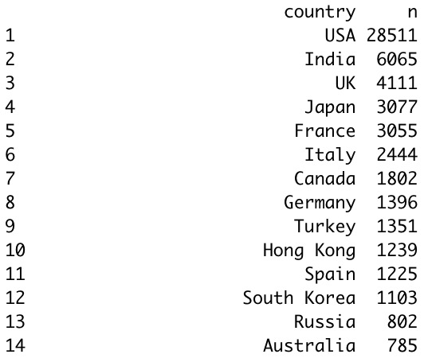
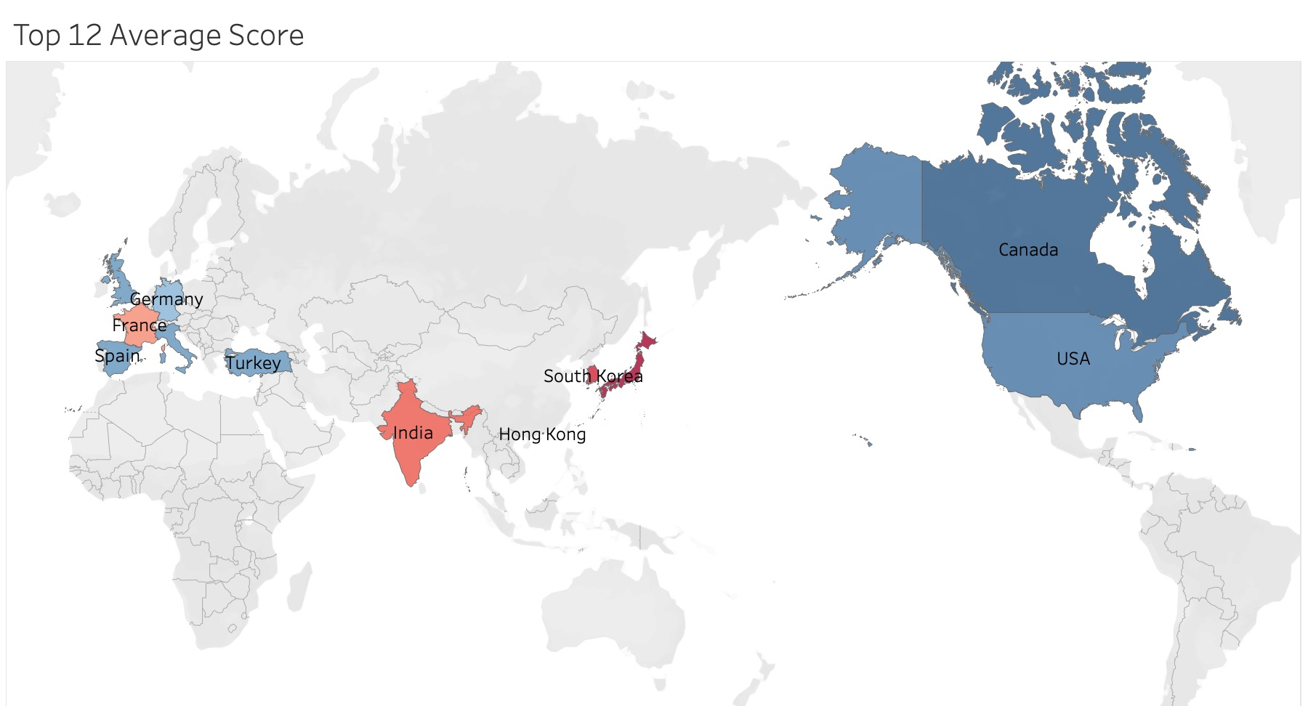
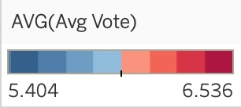
General Analysis-Country
!
South Korea: 6.384
Japan: 6.536
Research Topic: What affects US movies voting scores?

Slide 10
Sentiment Score
Filter out the country that whatever contains USA: 34325 observations;
Movie description-Sentiment analysis: lowest 5 & top 5
Average voting score: 5.18
Average voting score: 6.68
title | description | sentiment | avg_vote
A Life in the Balance | In Mexico City, a working-poor single-father is mistaken for a serial killer by the local cops but the man's son stumbles upon the real killer and tries to warn the police after being abducted. | -2.0875 | 6
Una ragazza sfrenata | A bratty teenager fakes her own kidnapping but gets mistakenly kidnapped for real instead. | -2.04455 | 5.4
The Runner | In the aftermath of the 2010 BP oil spill, an idealistic but flawed politician is forced to confront his dysfunctional life after his career is destroyed in a sex scandal. | -1.65965 | 4.7
L'assassino ti siede accanto | Mrs. Voorhees is dead, and Camp Crystal Lake is shut down, but a camp next to the infamous place is stalked by an unknown assailant. | -1.6525 | 6.1
Del Playa | Struggling with a horrific past, Claire Rhodes must confront a stalker turned murderer of her youth in order to win her life - but will her own demons help the killer exact his vengeance? | -1.63415 | 3.7
title | description | sentiment | avg_vote
Em | Instinctive mutual attraction brings Josh and Amanda together, but when that initial attraction blossoms into a rich romance, and the two decide to start a new life and a home together, secrets from the past emerge. | 1.216667 | 7.1
Stella | Chronicling a strong, but eccentric woman's devoted relationship to her daughter through the years. | 1.216039 | 6.2
Tom of Finland | Award-winning filmmaker Dome Karukoski brings to screen the life and work of artist Touko Valio Laaksonen (aka Tom of Finland), one of the most influential and celebrated figures of twentieth century gay culture. | 1.205635 | 6.8
Linda | Circumstances force a young woman to marry a much older man, although she really loves a young doctor. | 1.176154 | 6.8
All Together Now | An optimistic high schooler with musical aspirations must learn to accept help from her friends to overcome her personal hardships and fulfill her dreams. | 1.126765 | 6.5

Slide 11
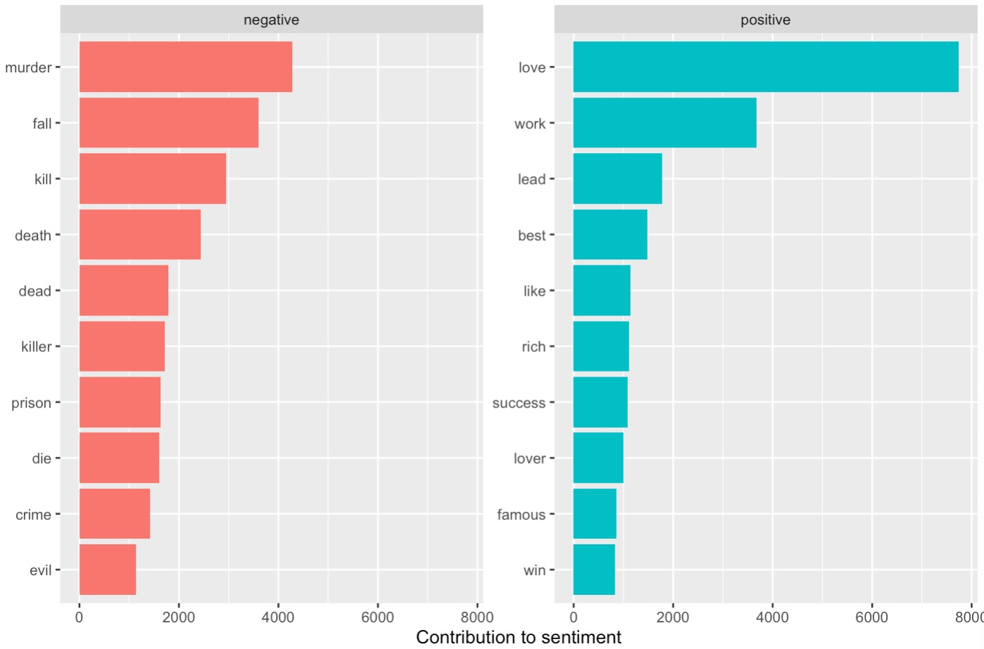
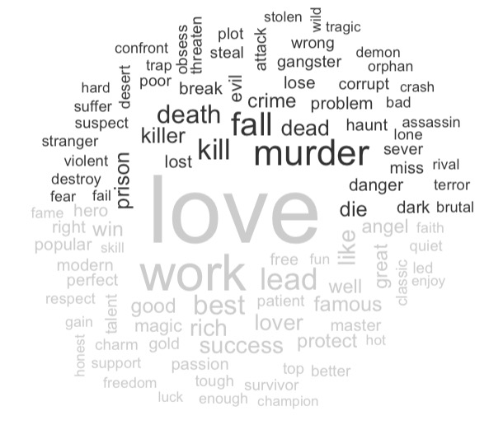
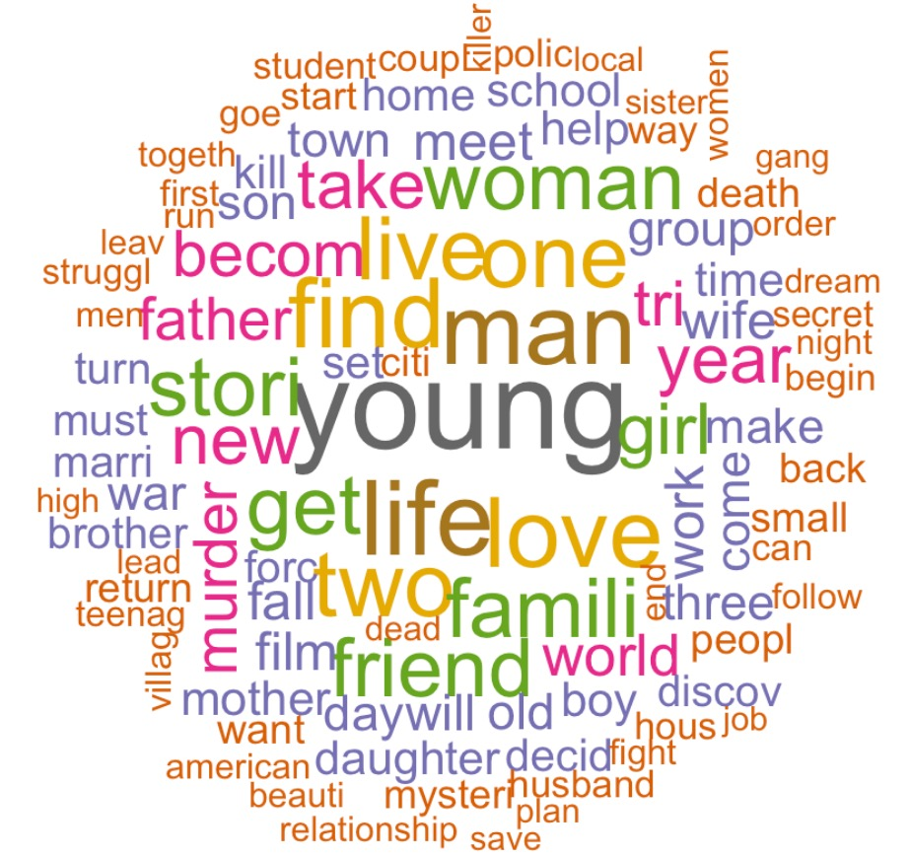
Text Analysis: Wordcloud
Words that contribute most to positive and negative sentiment in description
Negative
100 Most frequent words
Positive

Slide 12
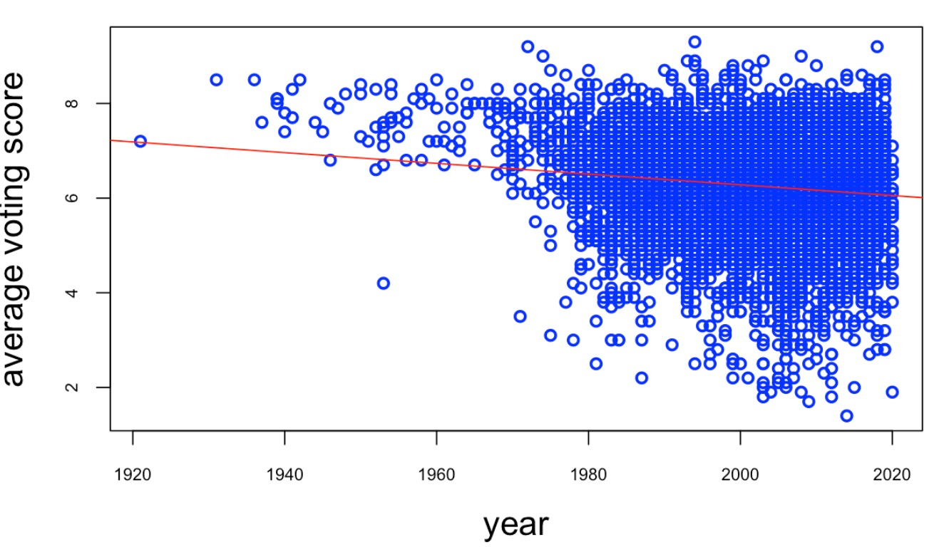
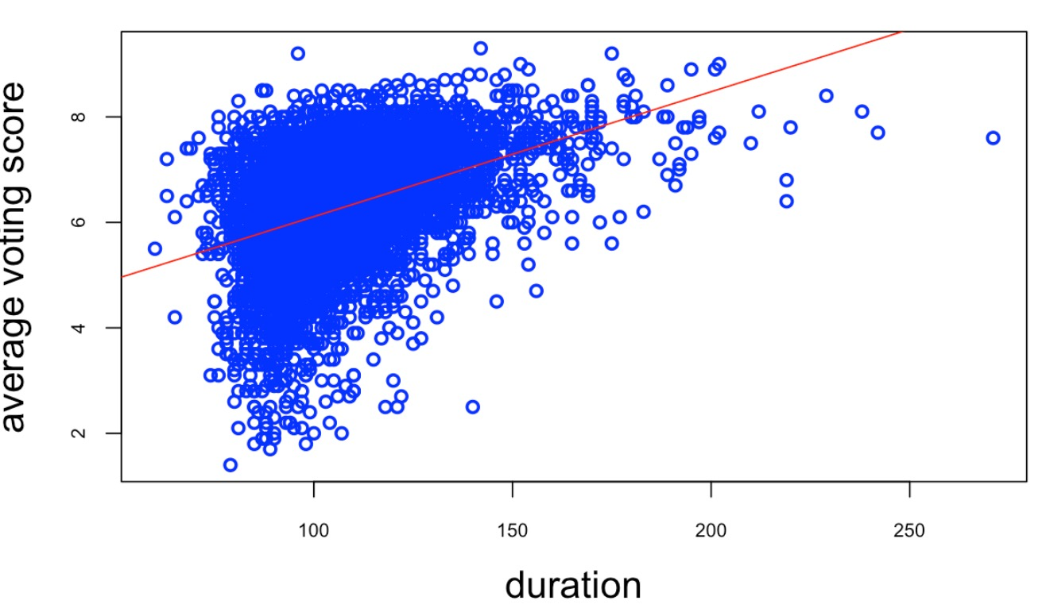
Simple Correlation Plot
Remove NAs in budget/gross income: 6530 observations;
Add number of types of genre/revenue/return on investment percentage as new numeric variables
Average voting score ~ year/movie time duration

Slide 13
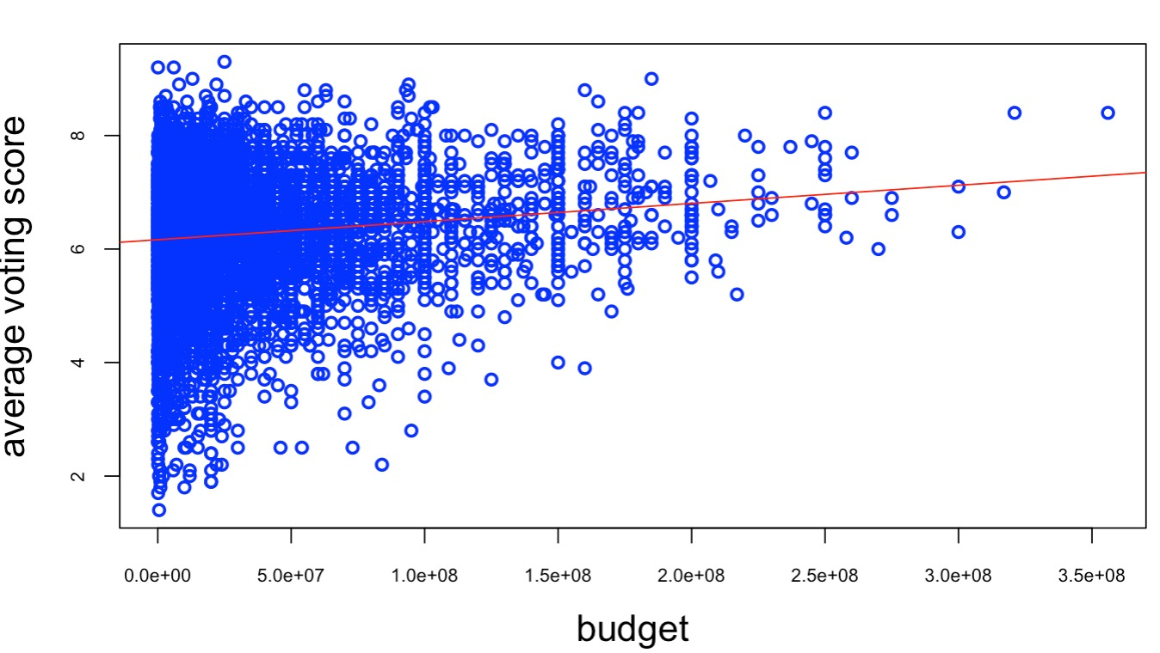
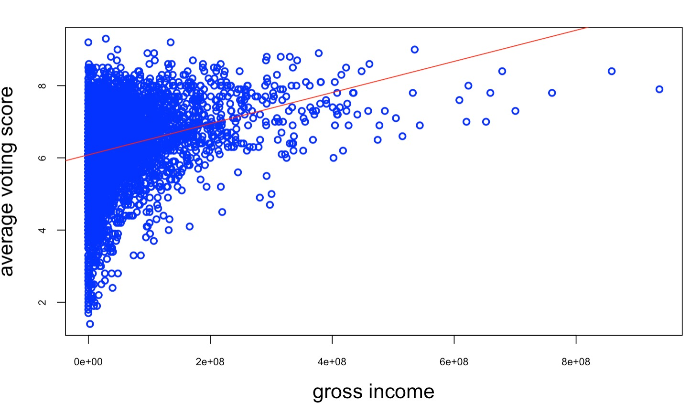
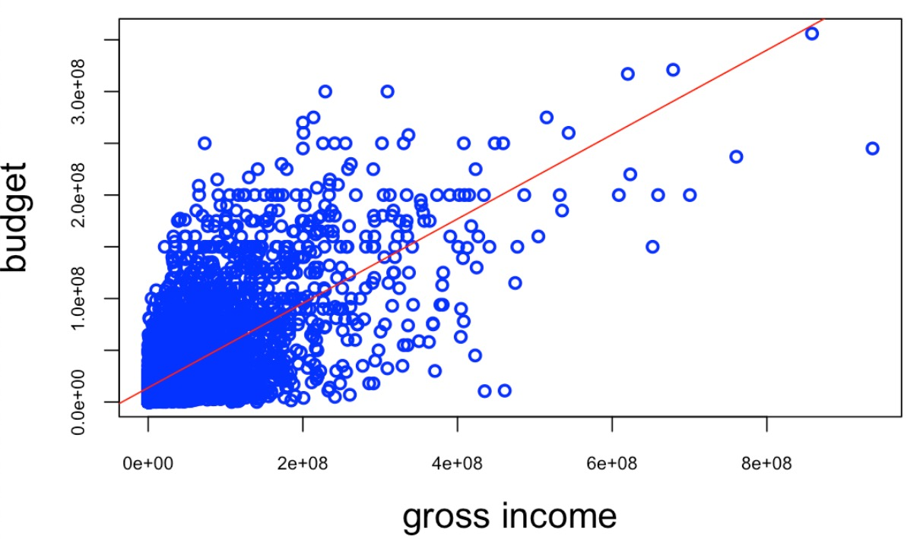
Simple Correlation Plot
Average voting score ~ budget/gross income
Budget ~ gross income

Slide 14
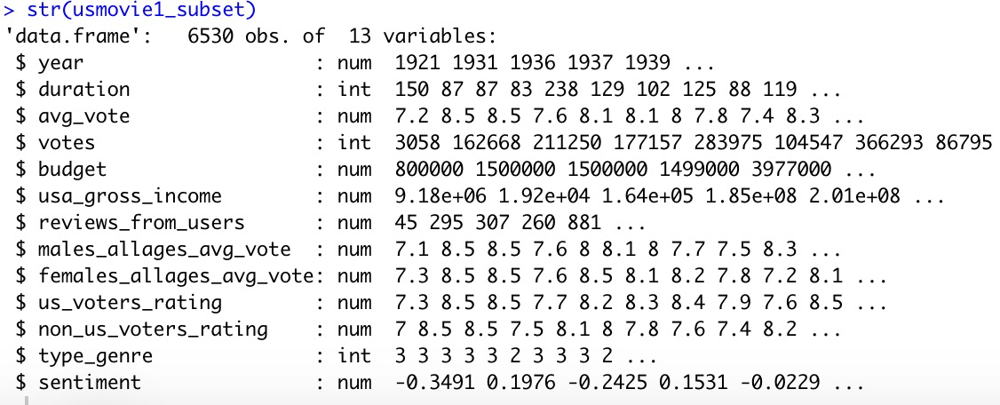
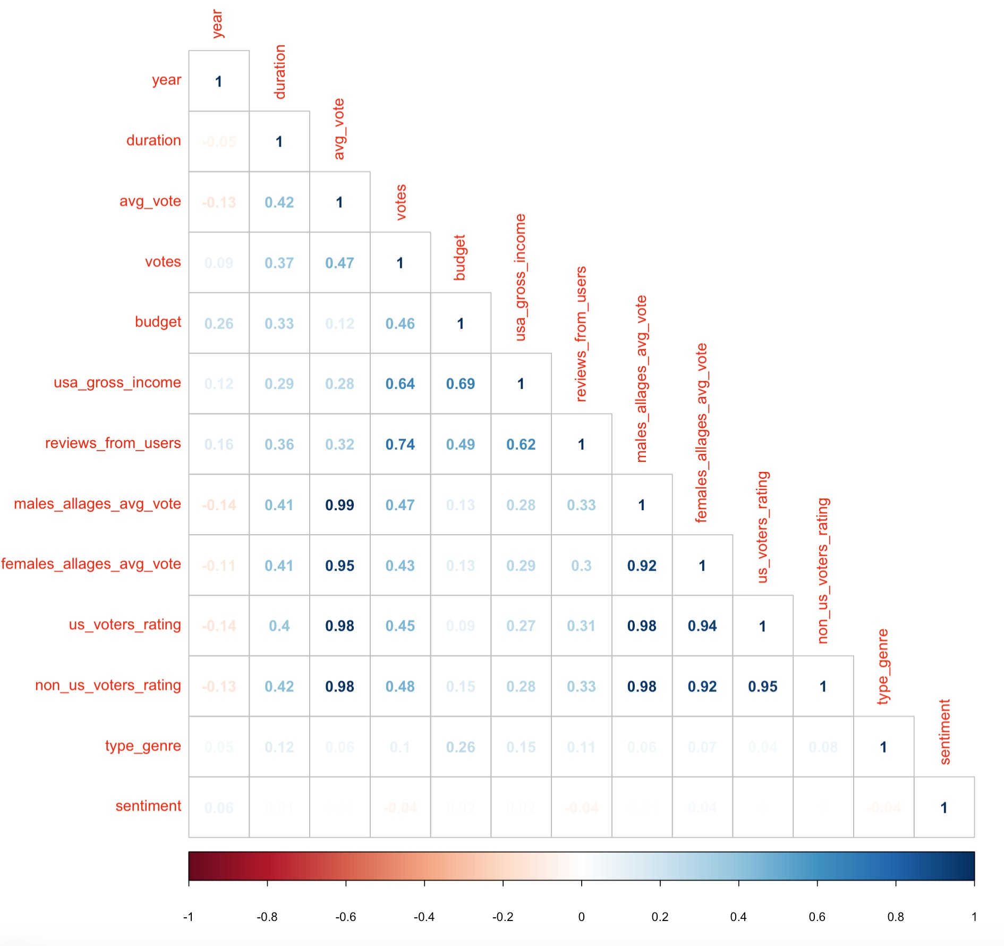
Linear Regression
Year
Movie time duration
Average voting score
Total votes
Budget
Gross income
Number of reviews
Males average voting score
Females average voting score
US people average voting score
Non-US voters’ average voting score
Number of types of genres:1-3
Sentiment score

Slide 15
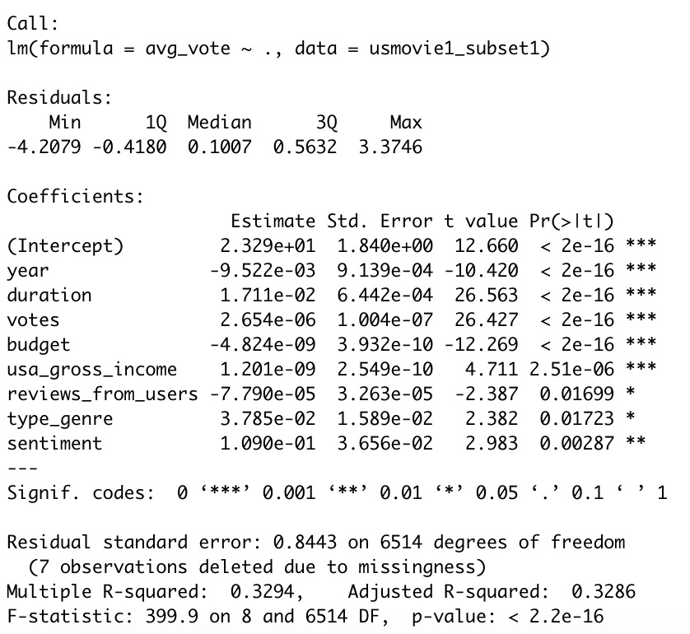
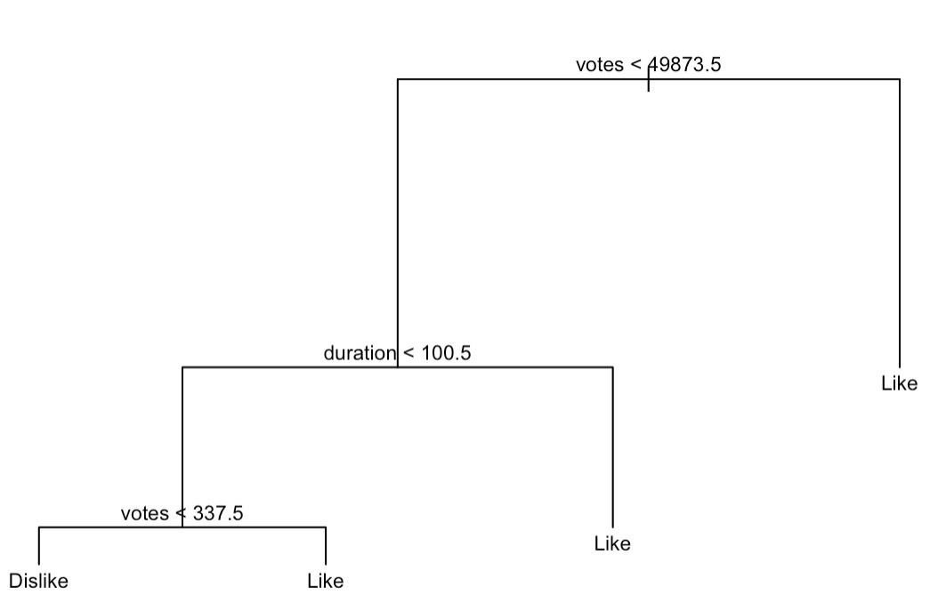
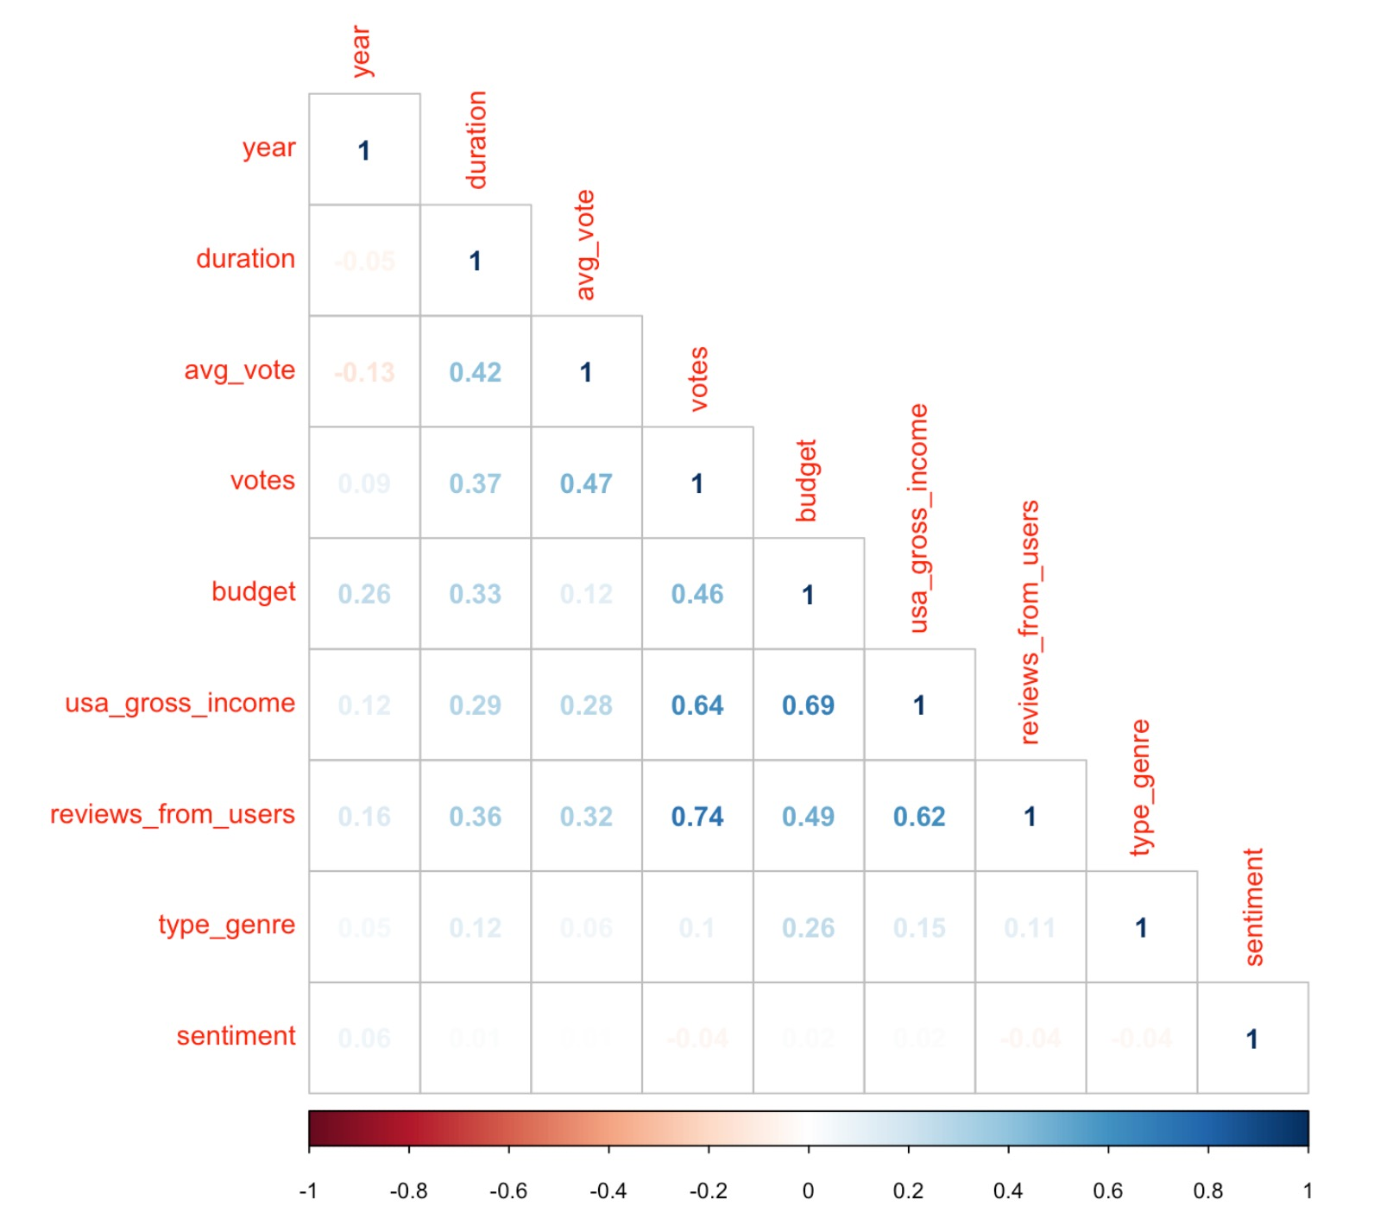
Linear Regression; Tree Model
3836/6530
likehood = factor(ifelse(usmovie1_subset1$avg_vote<5,"Dislike","Like"))

Slide 16
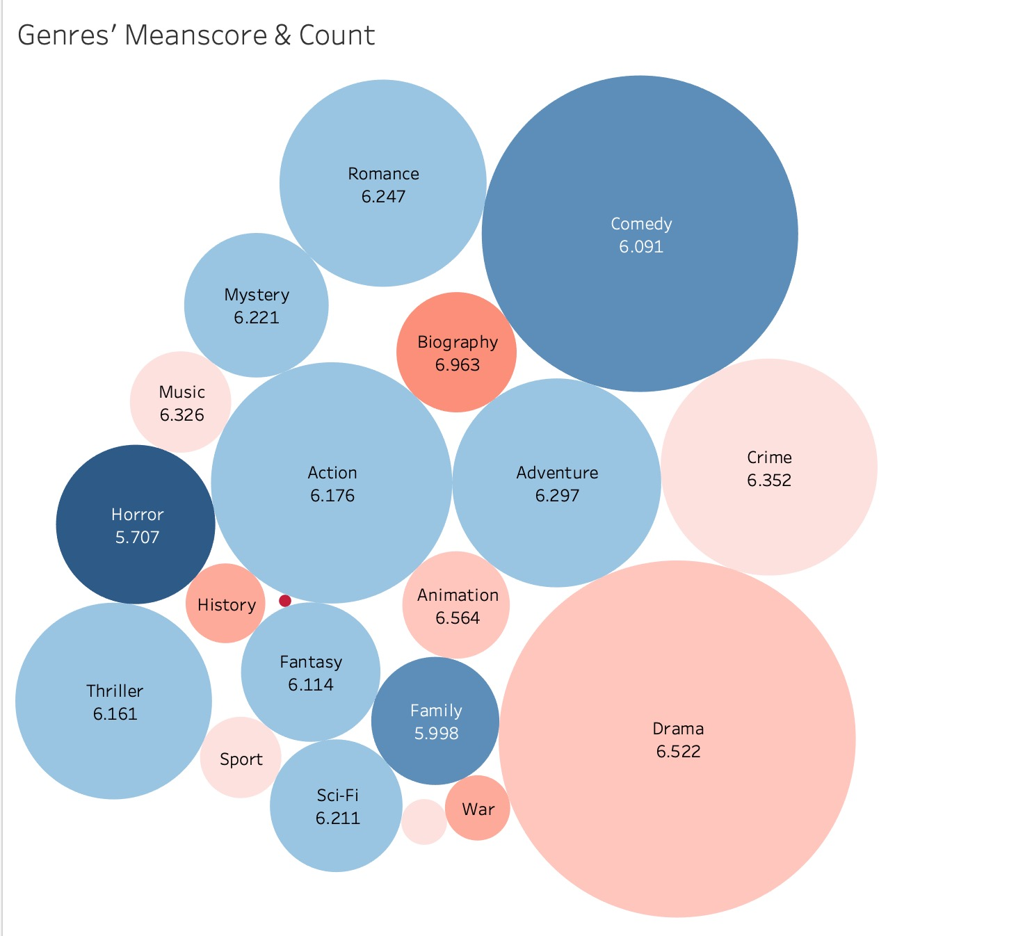
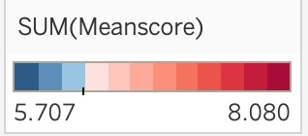
Each Genre’s Count & Meanscore
Top 3 genres with number of movies:
Drama, Comedy, Action
Top 3 genres with average voting score
Film-Noir, Biography, History
Film-Noir
7.825
*Bubble size represents the number of movies.
*Bubble color represents the average voting score: from blue to red, redder represents higher score.
6.881
6.366
Western
6.471
6.782

Slide 17
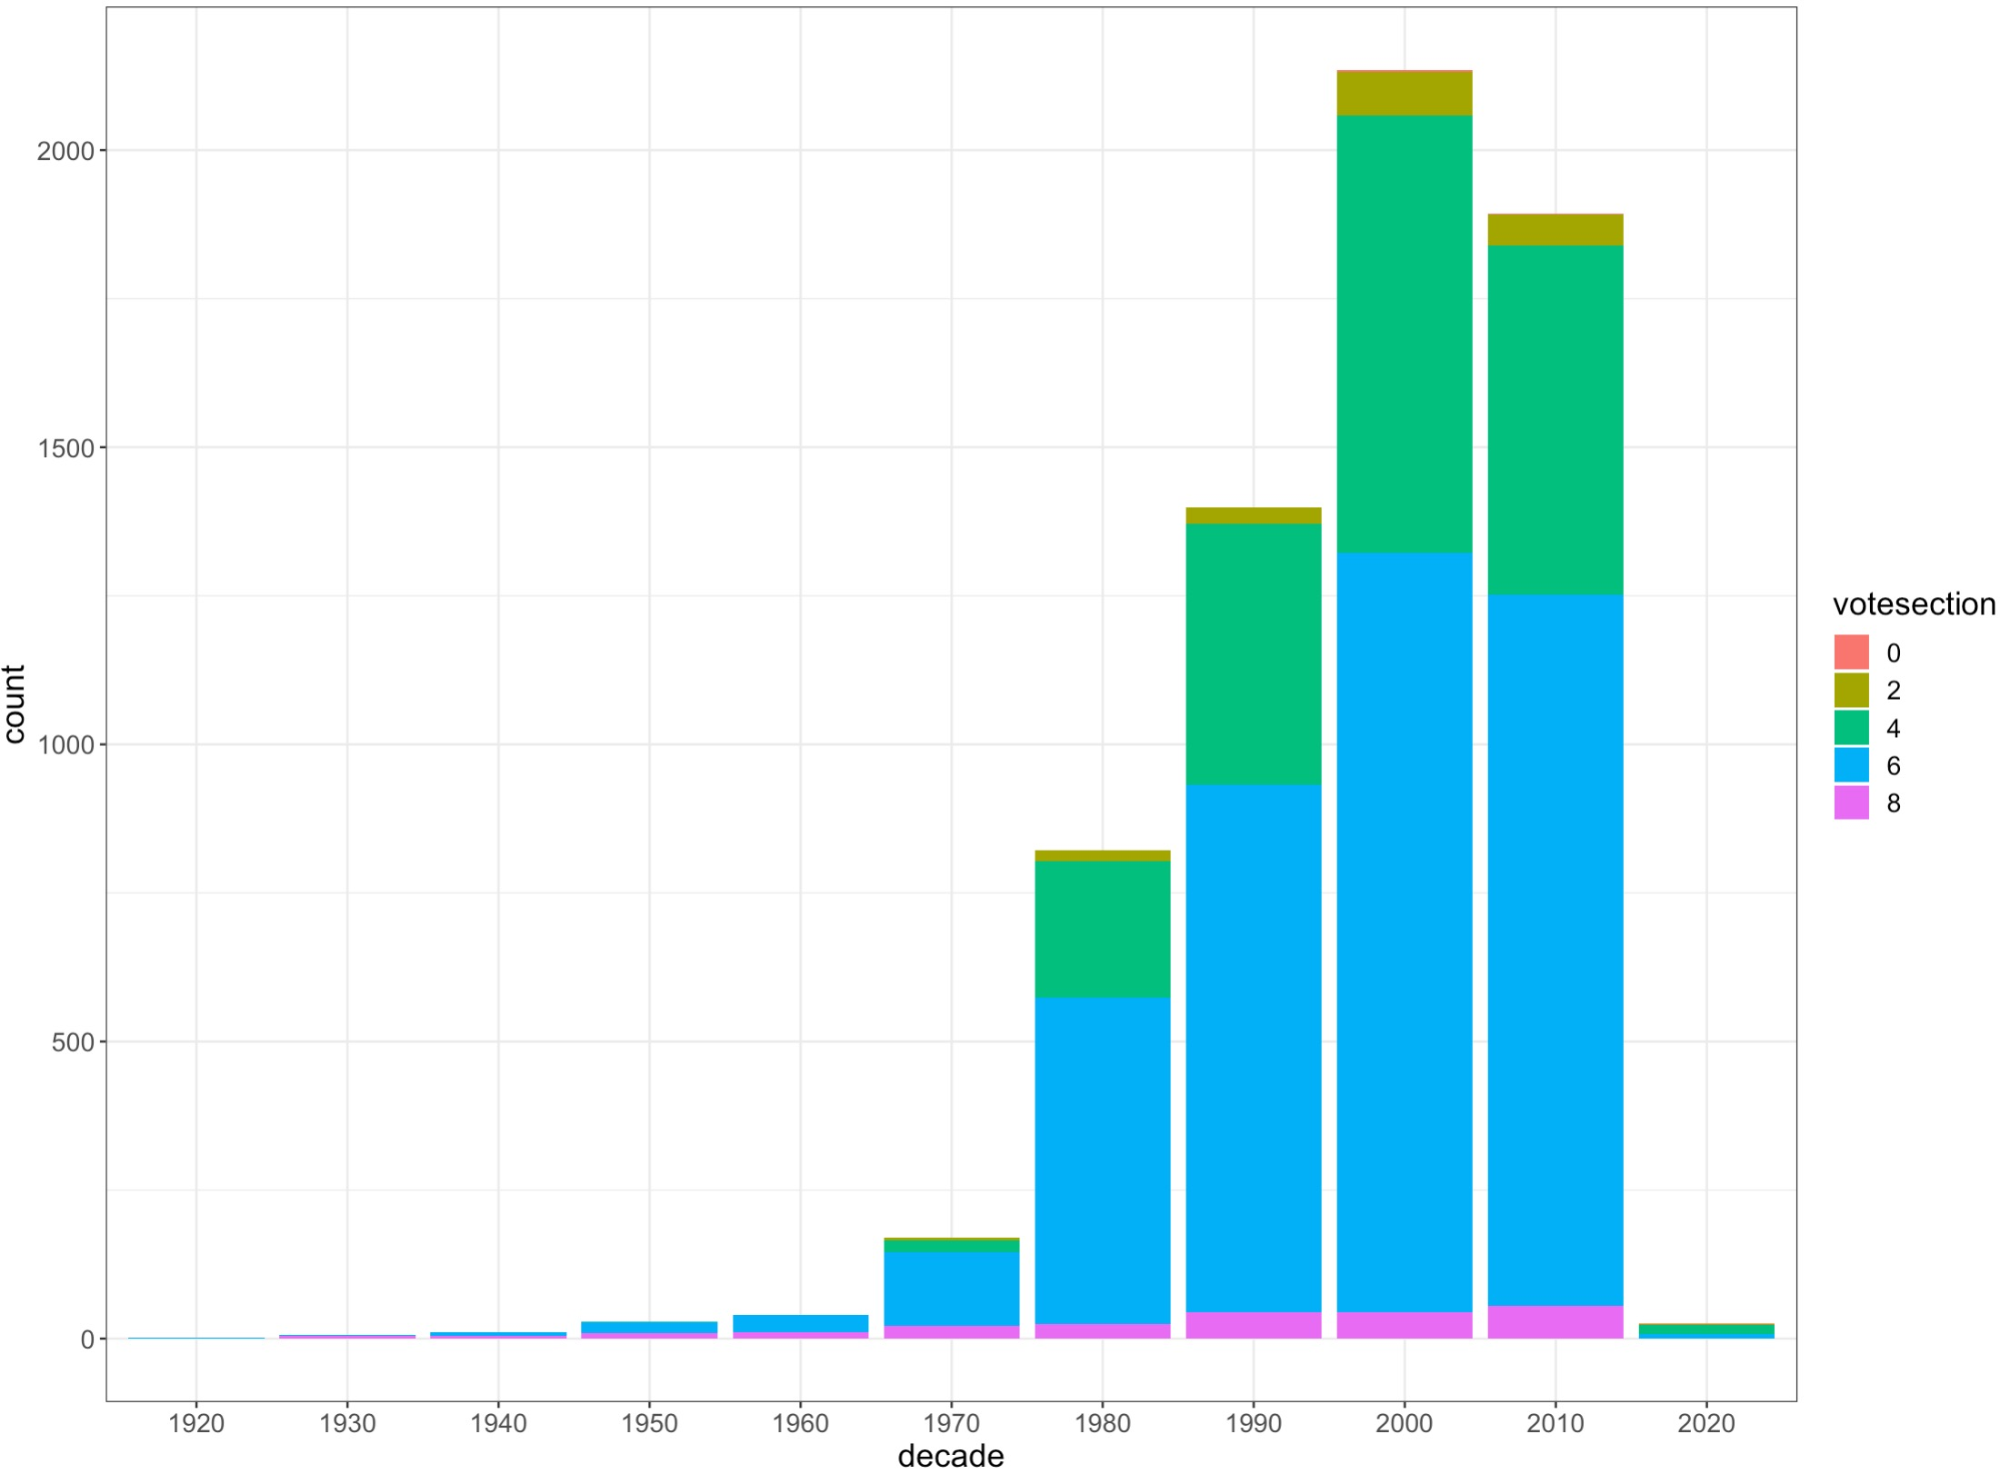
EDAs
Year into decades : [1890-2020]
Number of types of genres: Factor w/ 3 levels: “1”, “2”, “3”
Separate genre into 3 columns called “genre1”, “genre2”, “genre3”, and turn them into factor
Average vote score into vote sections: [0,2,4,6,8,10]
Vote sections against categorical variables: decade

Slide 18
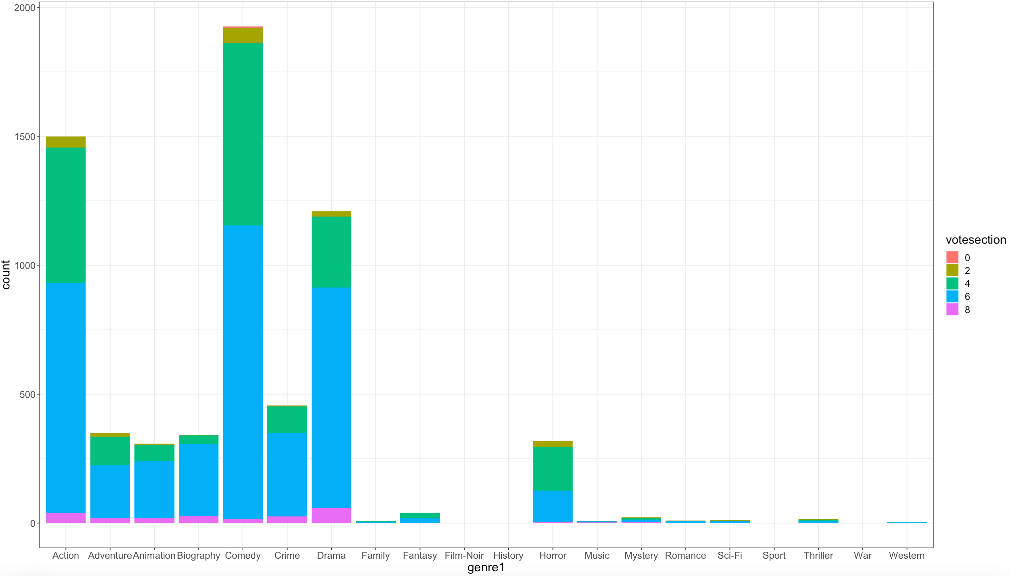
EDAs
Vote sections against categorical variables: genre1

Slide 19
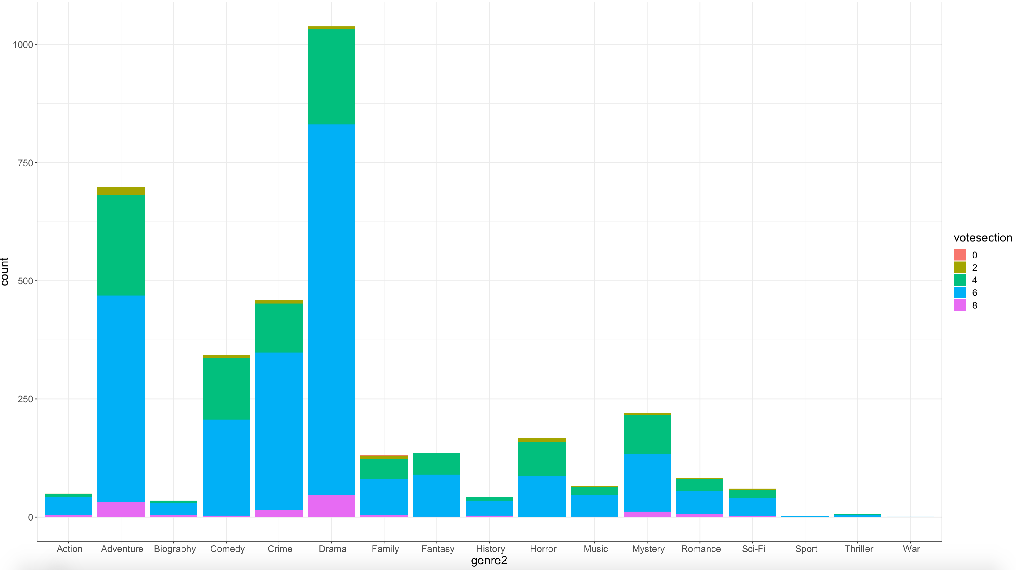
EDAs
Vote sections against categorical variables: genre2

Slide 20
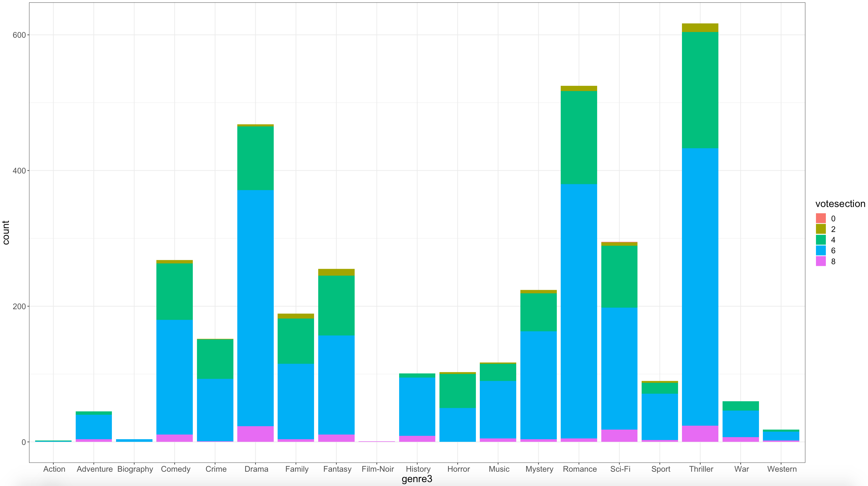
EDAs
Vote sections against categorical variables: genre3

Slide 21
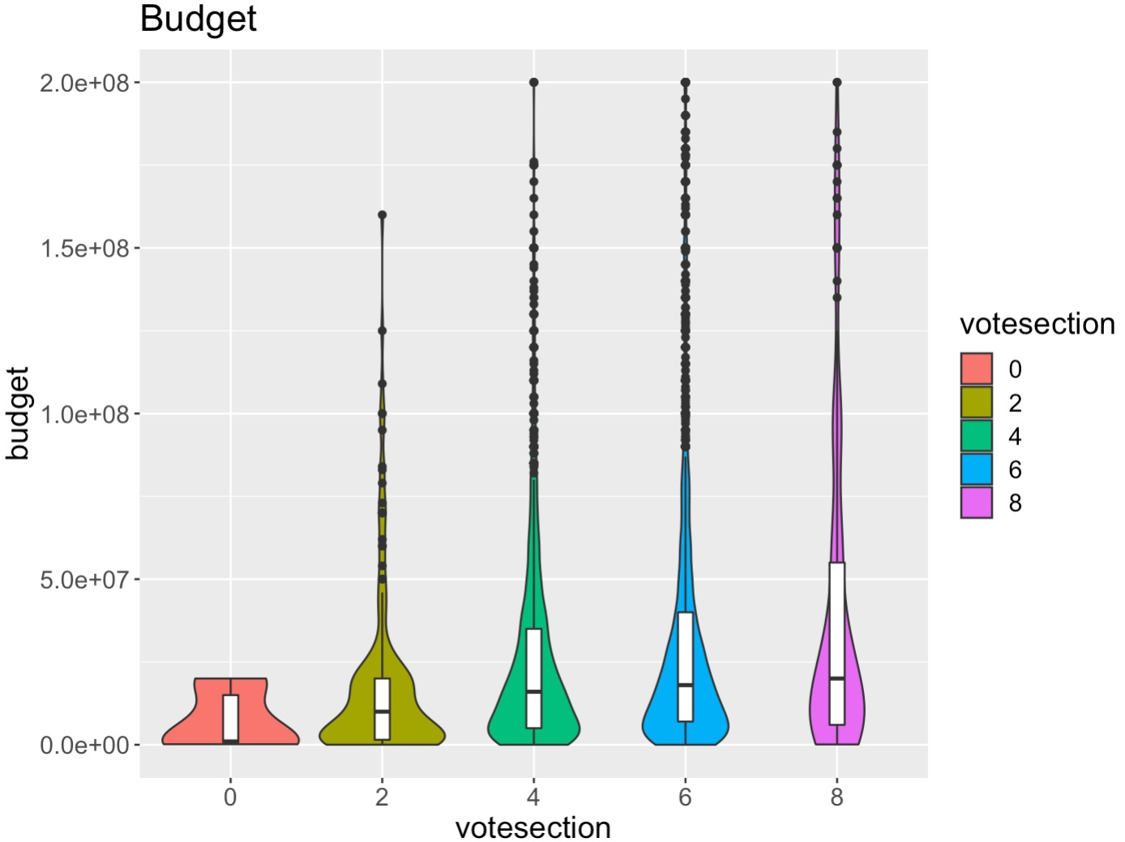
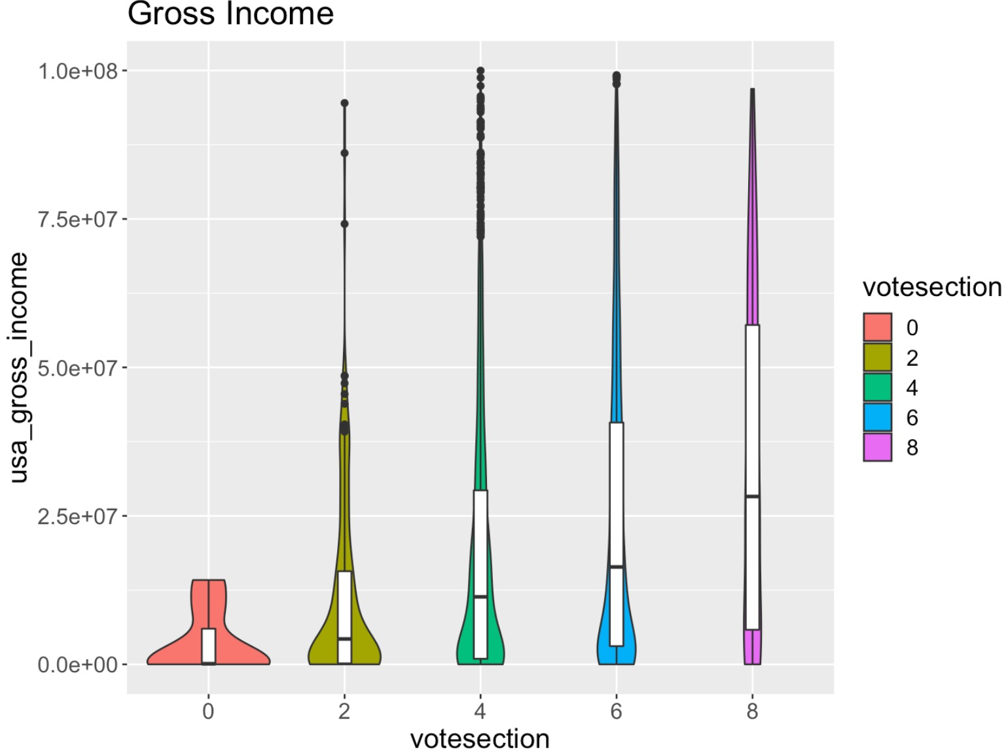
EDAs
Vote sections against numerical variables: budget & gross income

Slide 22
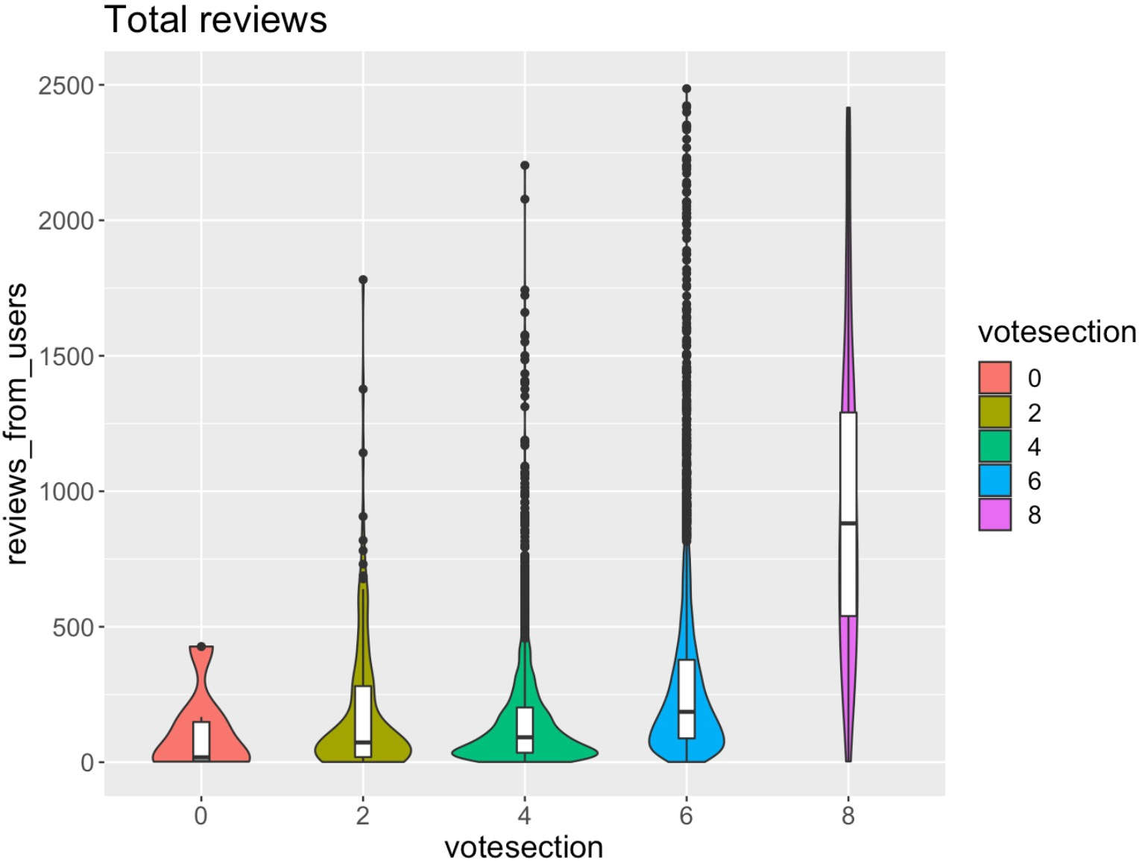
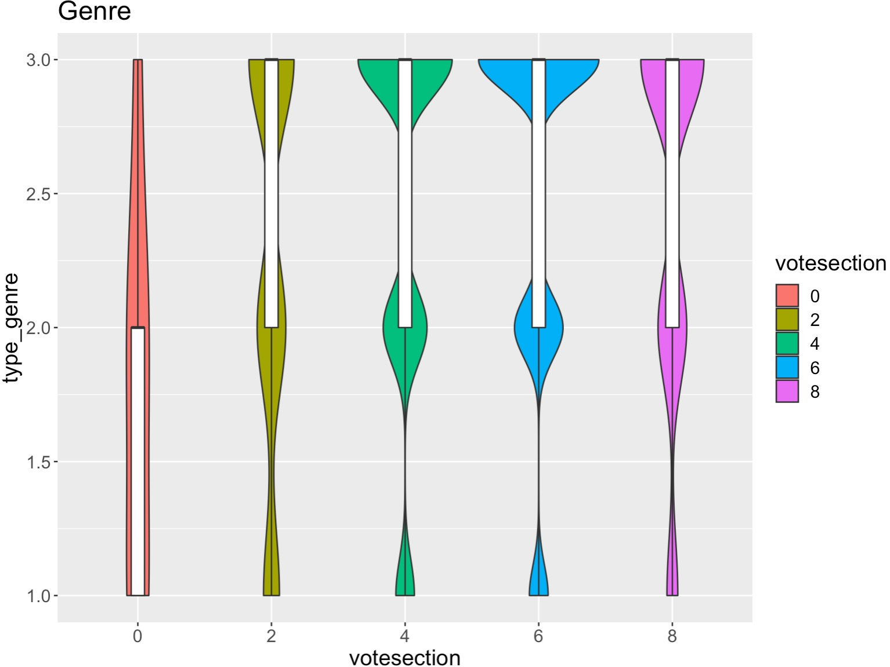
EDAs
Vote sections against numerical variables: total reviews & number of types of genres

Slide 23
Find the Best Logistic Regression Model
logit1 = glm(votesection ~ decade + duration + budget + votes ,usmovie1, family="binomial") summary(logit1) #AIC: 110.4
Add genre1/genre1+genre2/genre1+genre2+genre3 #AIC: 135.69/132.92/126
Replace decade with year #AIC: 99.003
Add sentiment score #AIC: 100.57
Add review from users #AIC: 100.92
Add gross income #AIC: 99.012
Add number of types of genre #AIC: 98.704
logit3 = glm(votesection ~ year + duration + budget + votes + type_genre, usmovie1, family="binomial")

Slide 24
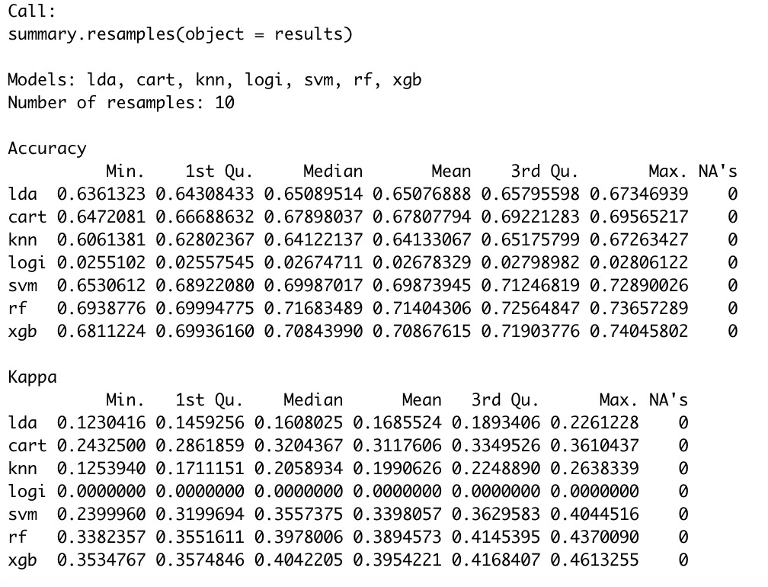
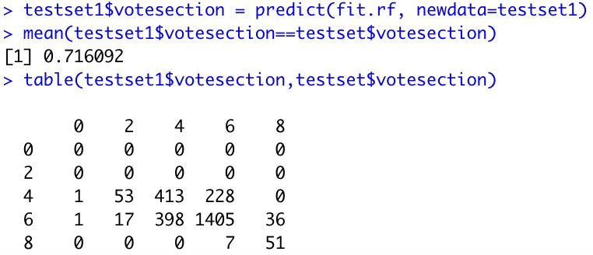
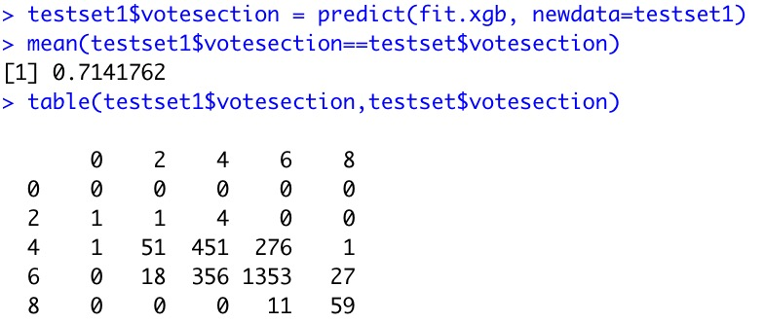
Prediction
Trainset: 3920 x 6
New dataset: 6530 x 6 (p=0.6)
Testset: 2610 x 6, remove the votesection answer column and name testset1 : 2610 x 5
10-Fold Cross-Validation
Linear Discriminant Analysis (LDA)
Classification and Regression Trees (CART)
k-Nearest Neighbors (KNN)
Bayesian Generalized Linear Model
Support Vector Machines (SVM)
Random Forest
XGBoost
Random Forest test set accuracy: 71.6%
XGBoost test set accuracy: 71.4%

Slide 25
Conclusion
Men are typically hasher critic reviewers than women;
Top movie genres people like to rate/see: Action, Adventure, Comedy, Drama, Crime, Thriller.
Year, duration, number of votes, budget, sentiment scores, etc. all influence rating scores. Number of types of genres affect rating score but genre itself doesn’t affect much.
Recommendation
Better use positive words in writing descriptions;
Encourage women to express more on voting/reviewing.

Slide 26
Thanks!
Any questions?

